Slide 1

Artificial Intelligence

Slide 2
Lecture # 10
Propositional Logic

Slide 3
Logic in General (1)
Logics are formal languages for representing
information such that conclusions can be drawn
When people talk about logic they often mean
propositional or first-order predicate logic.

Slide 4
Logic in General (2)
A logic usually has a well defined
syntax,
semantics and proof theory.
The syntax of a logic defines the syntactically
acceptable objects of the logic, or well-formed
formulae.
The semantics of a logic associate each
formula with a meaning.
The proof theory is concerned with
manipulating formulae according to certain
rules.

Slide 5
Propositional Logic
The syntax of propositional logic is
constructed from propositions and
connectives.
A proposition is a statement that is either
true or false but not both

Slide 6
Propositions???
Najib is Prime Minister
What is the time?
2 + 3 = 5
„Phone‟ has five letters.
2 + 3 = 6
Oh dear!
„Work‟ has five letters.
the reactor is on
2+3
All elephants have 4 legs
I like AI class

Slide 7





connectives
Propositions may be combined with other propositions
to
form compound propositions. These in turn may
combined into further propositions.
be
The connectives
and
or
Not
that
may
be used are
conjunction (& or .)
disjunction (| or +)
negation (~)
implication ( )
if
…..then
if and only if
Some books use different
given in parentheses.
equivalence (
)
notations. Some of these
are

Slide 8
Propositional Logic: Syntax
■ The proposition symbols P1, P2 etc are sentences
■ If S is a sentence,
S is a sentence (negation)
■ If S₁ and S₂ are
■ If S₁ and S₂ are
■ If S₁ and S₂ are
■ If S₁ and S₂ are
sentences, S1
sentences, S₁
sentences, S₁
sentences, S₁
S2 is a sentence (conjunction)
S₂ is a sentence (disjunction)
S₂ is a sentence (implication)
S₂ is a sentence (equivalence)

Slide 9
Propositional Logic: Semantic
Each model species true/false for each
proposition symbol
E.g.
P
true
Q
true
R
false
Why
8?
(With these symbols, 8 possible models, can
enumerated automatically.)
Rules for evaluating truth with respect to a model m are determined by truth tables
be

Slide 10

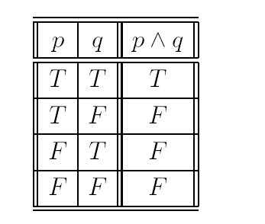
And
(also called conjunction)
The conjunction ‘p AND q’, written p
q, of two
propositions is true when both p and q are true,
otherwise.
false
We can summarise the operation of
using a truth
table. Rows in the table give all possible setting of the
propositions to true (T) or false (F).
p
q

Slide 11
Natural
Language Meaning
(1)
p
q p
Its Monday.
Its raining.
Its Monday and its raining.
Its Monday but its raining.
Its Monday. Its raining.
^
q

Slide 12
Natural Language
Meaning
Caution:
semantics?
p
q
p ^ q q ^ p
I took a shower
I woke up
“I took a shower and I woke up” “I woke up and I took a shower”.
Logically the same! WE may see a difference.
The word both is often useful eg. I both took a shower
and I woke up.

Slide 13

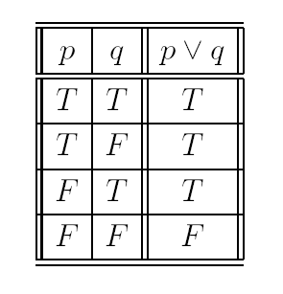
Or
Also called disjunction.
The disjunction „p OR q‟, written p q, of two propositions is true when p or q (or both) are true, false otherwise.
Sometimes called inclusive or.
p
q

Slide 14

Natural Language Meaning
p
q p
It‟s Monday.
It‟s raining.
q It‟s Monday or it is raining.
The word either is often useful eg. either it’s Monday
or it is raining.
It also includes the case of rain on a Monday!

Slide 15

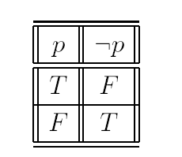
Not
Also known as negation
The negation „NOT p‟ of a proposition (or
p) is true when
p
is
false
false
and
that
is false
p.
otherwise. p may
be
read
that
it
is
p
Negation
is a
unary connective. It only takes one argument.
Conjunction and disjunction were both binary connectives.

Slide 16
Natural Language Meaning
p
Logic is easy.
It is false that logic is easy.
It is not the case that logic is easy. Logic is not easy.
p

Slide 17


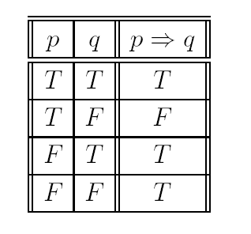
If . . . then
Also known as implication
The implication „p IMPLIES q‟, written p
q, of two
propositions is true when either p is false or q is true, and
false otherwise.
p
q

Slide 18
Natural Language Meaning
p
q p
I study hard.
I get rich.
If I study hard then I get rich.
Whenever I study hard, I get rich.
That I study hard implies I get rich.
I get rich, if I study hard.
q

Slide 19
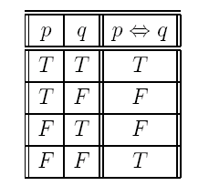
Biconditional
Also known as iff or the biconditional.
The biconditional, written as p
q
, of two
propositions is true when both p and q are true or
when both p and q are false, and false otherwise.

Slide 20
Natural Language Meaning
If I have a triangle, then my polygon has only three sides.
If the polygon has only four sides, then the polygon is a quadrilateral.
If the quadrilateral has four congruent sides and angles, then the quadrilateral is a square.

Slide 21
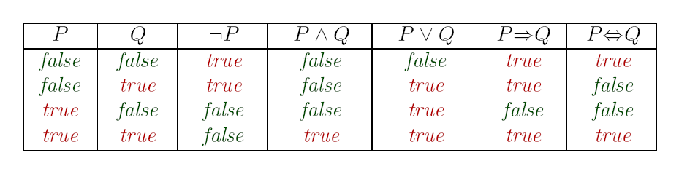
Recap: Truth Tables

Slide 22
Truth Tables for Compound Propositions
■
■
■
■
■
■
Truth tables may be used to show interpretations of
compound propositions.
To draw up a truth table, construct a column for each proposition involved.
You need
2^{n}
rows for n propositions for all possible ways
of
setting the propositions to T and F.
If we have 3 propositions, p; q; r, i.e. we need
2³
= 8 rows.
Next, construct a column for each connective, the most deeply
nested first.
Evaluate each column using values for propositions or previous columns.

Slide 23
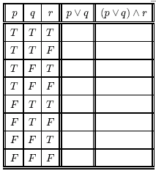
Exercise
p.. (my breakfast is) eggs.
q.. (my breakfast is) cereal.
r.. (my breakfast is) toast.
The statement „my breakfast is
either eggs or cereal, and toast‟ may be written in symbolic form as ???
WHAT DOES THE TABLE
TELL U?

Slide 24
... So
The truth table gives results for all possible
interpretations of p, q and r. The
proposition is true if
compound
I
eat
eat
eat
cereal, eggs and
cereal and toast;
eggs and toast.
toast; or
or
I
I
Interpretation - A line in the truth table.

Slide 25
Assignments and Models
Each line of a truth table represents a different possibility called an assignment of the truth values to the propositions.
An assignment which makes the expression true is said to be a model for the expression.
An assignment which makes the expression false is said to be a counter-example.

Slide 26

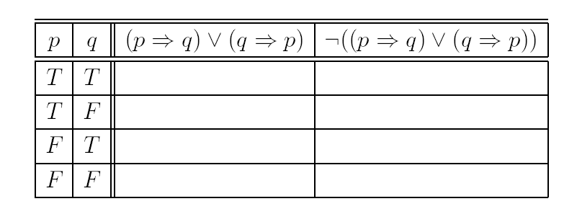
Try this..
Complete
the
truth
table
for
.

Slide 27
Satisfiable and Valid
A formula is valid if it is true for all values of its terms. Valid if all values it returns in the truth table are true .
A proposition is satisfiable if there is at least one true result in its truth table.

Slide 28
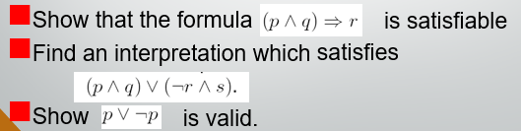
DIY

Slide 29
DIY
Example 1: Formalize in propositional logic:
a = ‘It is early in the morning’
b = ‘It is late at night’
c = ‘I take a taxi’
d = ‘I use the train’
e = ‘I am abroad’
When it is early in the morning or late at night and I am abroad I take a taxi.
If it is early in the morning and I am not abroad I always use the train.
If it is late at night and I am not abroad then I use either the train or the taxi.

Slide 30
DIY
Example 1: Formalize in propositional logic:
a = ‘It is early in the morning’
b = ‘It is late at night’
c = ‘I take a taxi’
d = ‘I use the train’
e = ‘I am abroad’
When it is early in the morning or late at night and I am abroad I take a taxi.
(a v b) ^ (e → c)
If it is early in the morning and I am not abroad I always use the train.
(a ^ ~e) <---> d
if it is late at night and I am not abroad then I use either the train or the taxi.
(b ^ ~e) -> (d v c)

Slide 31
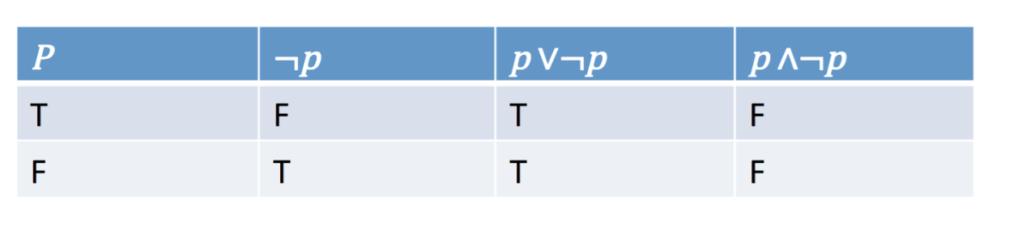
Tautology and contradiction
• Tautology is a proposition which is always true. It is also valid.
• Contradiction is a proposition which is always false. It is unsatisfiable.
• Contingency is a proposition which is neither a tautology nor a contradiction

Slide 32
Tautology Example
The truth table for: p → (p V q), is a tautology, as shown below.
p | q
T T F F | T F T F
(p V q)
p → (p V q)
T
T
T
T
T
T
F
T

Slide 33
Contradiction Example
The truth table for: (p V q) Λ (¬p Λ ¬q), is a contradiction, as shown below.
p | q
T T F F | T F T F
(p V q)
¬p
¬q
¬p Λ ¬q
(p V q) Λ (¬p Λ ¬q)
T
F
F
F
F
T
F
T
F
F
T
T
F
F
F
F
T
T
T
F

Slide 34
Contingency Example
The truth table for: (p Λ q) → ¬p , is a contingency, as shown below.
p | q
T T F F | T F T F
(p Λ q)
¬p
(p Λ q) → ¬p
T
F
F
F
F
T
F
T
T
F
T
T

Slide 35
Assignments and Models
Each line of a truth table represents a different possibility called an assignment of the truth values to the propositions.
An assignment which makes the expression true is said to be a model for the expression.
An assignment which makes the expression false is said to be a counter-example.

Slide 36
Logical Equivalence of Conditional and Contrapositive
The easiest way to check for logical equivalence is to see if the truth tables of both variants have identical last columns:
p
q
p →q
p
q
¬q
¬p
¬q→¬p
T
T
F
F
T
F
T
F
T
F
T
T
T
T
F
F
T
F
T
F
F
T
F
T
F
F
T
T
T
F
T
T

Slide 37
Converse, Contrapositive and Inverse
We start with the conditional statement “If P then Q.”
The converse of the conditional statement is “If Q then P.”
The contrapositive of the conditional statement is “If not Q then not P.”
The inverse of the conditional statement is “If not P then not Q

Slide 38
Converse, Contrapositive and Inverse
p: If it is raining
q: grass is wet
Given an implication p → q
If it is raining then grass is wet
• The converse is: q → p
If Grass is wet then it is raining
• The contrapositive is: ¬q → ¬p
• The inverse is: ¬p → ¬q

Slide 39
Converse, Contrapositive and Inverse
The contrapositive of a conditional statement of the form "If p then q" is "If ~q then ~p". Symbolically, the contrapositive of p q is ~q ~p.
A conditional statement is logically equivalent to its contrapositive. A conditional statement is not logically equivalent to its inverse.
For example, the contrapositive of "If it is raining then the grass is wet" is "If the grass is not wet then it is not raining."

Slide 40
Exercise
Construct a truth table for
(p<---> q) <---> (r<---> s)
((p---> q) --->r) ---> s
(p V q)^ ~r

Slide 41
Exercise
Let p be the “ the election is decided” and
Q= the votes have been counted.
Translate the following proposition into Propositional logic
~p
P V q
~p ^ q
~q →~p
P< ---> q

Slide 42
Exercise
Convert the following sentence into PL
You will get an A in this class if and if you either do every exercise in this book or you get an A in the final
Berries are ripe along the trail, but grizzly bears have not been seen in the area.
It is below freezing but not snowing.
Swimming at the new jersey shore is not allowed and either swimming at the new jersey shore is allowed or shark have not been spotted near the shore.

